Slide 1
- EDGE – why EDGE?, what is it?, & a few examples - EDGE – the model, the tools, the value -The “Power of Mentoring” - Personal impact from EDGE & Next steps
Objectives of Our Call

Slide 2
- First Group Started 2008 - 3 Founding Members - Group now has 10 members - T@W started “Emerging Leaders” Group 2010 - 2 additional groups started in last two months
History of EDGE

Slide 3
- Jeff Simmons & Ray Hilbert met -2009 - Began formulating partnership and transitioning EDGE under T@W umbrella - T@W responsible for implementing model
History of EDGE

Slide 4
- Non profit ministry founded in 1998 - Focus : roundtable program for Christian business owners/executives - nearly 500 Members – 17 Chapters nationally - 2012 goal : add 25-30 new Chapters - Grow to over 1,000 Members
Background of Truth@Work

Slide 5
- Excellent partnership - T@W Members – serve as Mentors - T@W provides office / admin support - EDGE- young and emerging Christian Leaders
Truth@Work & EDGE

Slide 6
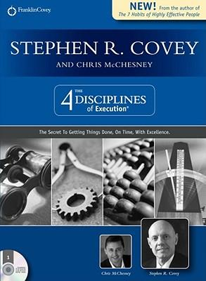
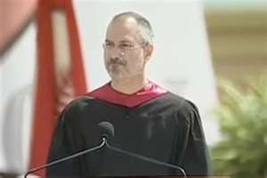
EDGE Examples in 2011
Edge
Member
Sharing
Abiding &
Abounding
3 Leadership differentials
Impact of Giving
Attacking
Sin

Slide 7
- Romans 12:6-8 ⁶ We have different gifts, according to the grace given to each of us. If your gift is prophesying, then prophesy in accordance with your^{[a]} faith; ⁷ if it is serving, then serve; if it is teaching, then teach; ⁸ if it is to encourage, then give encouragement; if it is giving, then give generously; if it is to lead,^{[b]} do it diligently; if it is to show mercy, do it cheerfully. - 2 Timothy 2:2 ² And the things you have heard me say in the presence of many witnesses entrust to reliable people who will also be qualified to teach others. Proverbs 27:17 ¹⁷ As iron sharpens iron, so one person sharpens another

Slide 8
- Meeting Format - Program Currriculum - How To Apply Ray Hilbert- CEO Truth@Work
Overview of EDGE Site / Model

Slide 9
- “Turn Key” Model - Website Review - Meeting Format Ray Hilbert- CEO Truth@Work
The MENTOR Opportunity

Slide 10
-Paired with emerging leaders who are called/committed to become godly leaders -A chance to "give back" part of the blessings God has given you and share what you have learned - A "turn key" system complete with content, curriculum, and a state of the art technology platform - Learn from young leaders what you need to know to remain relevant as a leader today - A group of your peers from across the country to share in this life changing experience - Exposure to some of the most cutting edge leadership concepts and materials available today - Personal/Professional/Spiritual "Life Integration“ - A growing network for personal & professional connection Ray Hilbert- CEO Truth@Work
The MENTOR Opportunity

Slide 11
- Building Into Next Generation - Sharing Your Experiences / Insights - “Turn Key Model www.edgementoring.com Ray Hilbert- CEO Truth@Work
The MENTOR Opportunity

Slide 12
- Building Into Next Generation - Sharing Your Experiences / Insights - “Turn Key Model www.edgementoring.com Ray Hilbert- CEO Truth@Work
The MENTOR Opportunity

Slide 13
Curriculum Overview

Slide 14
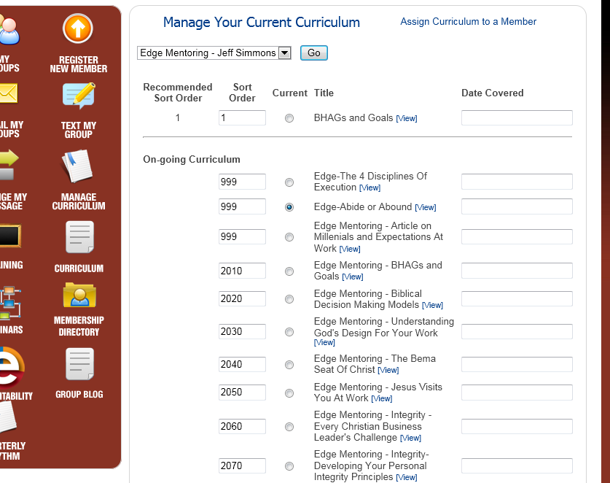
Visit www.edgementoring.com Click on “Register” Link
To Apply

Slide 15
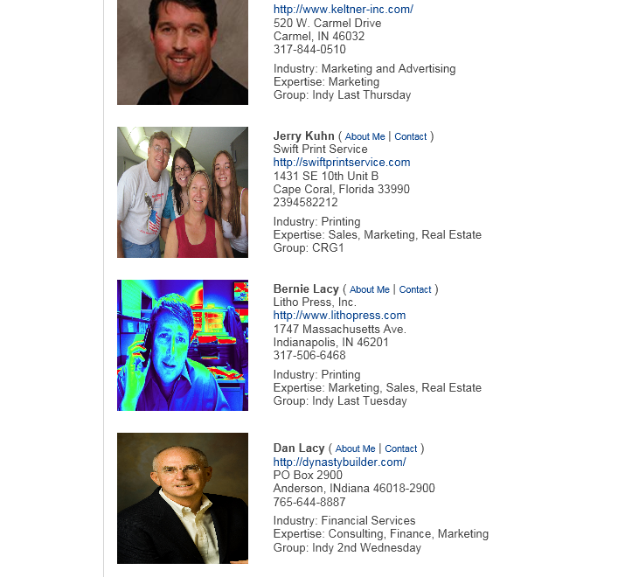
Visit www.edgementoring.com Click on “Register” Link
To Apply

Slide 16
Visit www.edgementoring.com Click on “Register” Link
To Apply

Slide 17
Visit www.edgementoring.com Click on “Register” Link
To Apply

Slide 18
Visit www.edgementoring.com Click on “Register” Link
To Apply

Slide 19
Visit www.edgementoring.com Click on “Register” Link
To Apply

Slide 20
Time: Hours : 3- 4 hours/month Financial: $25 /month recommended (scholarships available)
Investment

Slide 21
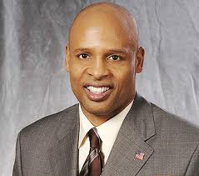
Mr. Clark Kellogg NBA Great NCAA All American CBS NCAA Lead Basketball Analyst Indiana Pacers V.P. of Player Development
The Power Of Mentoring

Slide 22
- “Best of the Best” - Serious about their Christian walk - Emerging Leader (last year or two of college to mid to late 20’s) - Business / Marketplace / Non – Profit Leaders - Only looking for those who are very serious about their personal / professional / spiritual growth - Willing to invest time, effort, energy, financial resources
Mentee Profile

Slide 23
- “Best of the Best” - Serious about their Christian walk - Proven Leader - Business / Marketplace / Non – Profit Leaders - Only looking for those who are very serious about their personal / professional / spiritual growth and investing in “next generation” - Willing to invest time, effort, energy, financial resources
Mentor Profile

Slide 24
Visit www.edgementoring.com Click on “Register” Link
To Apply
www.edgementoring.com

